Slide 1
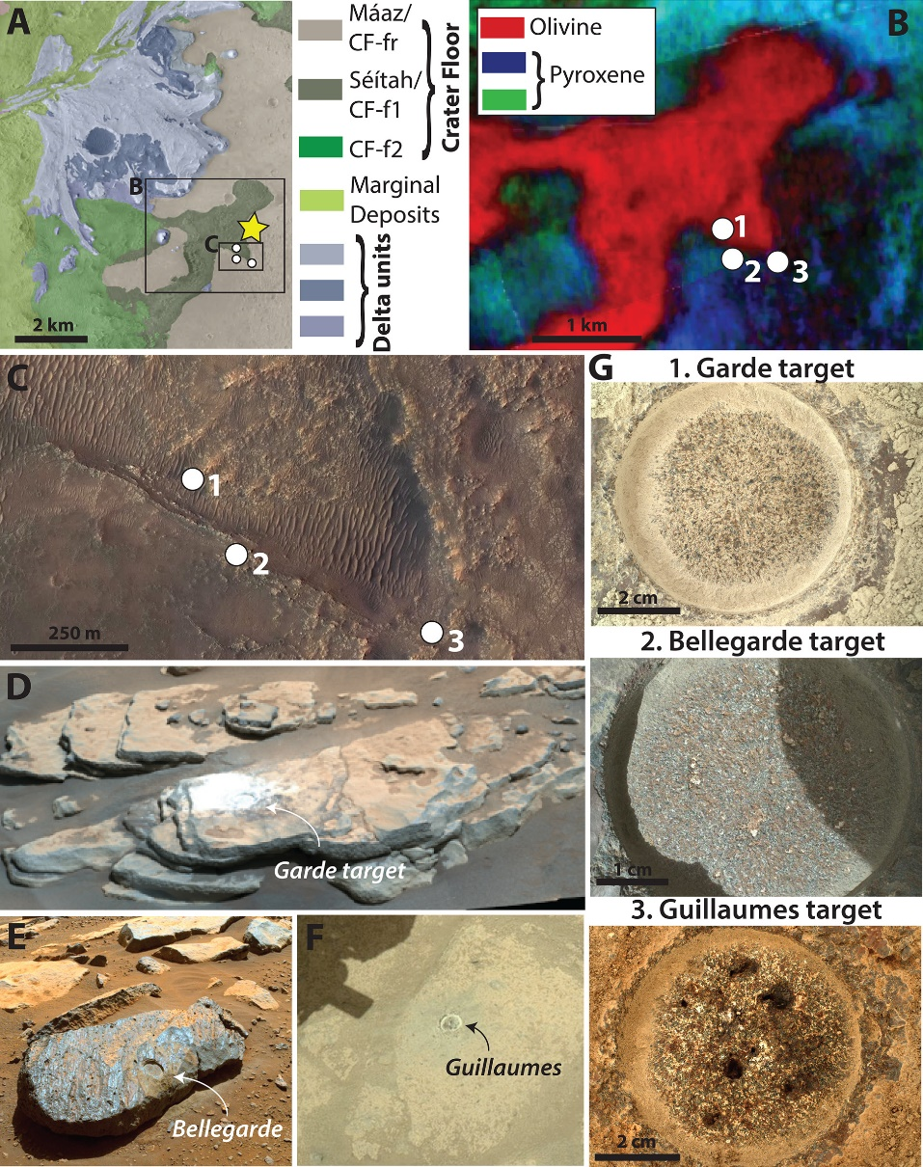
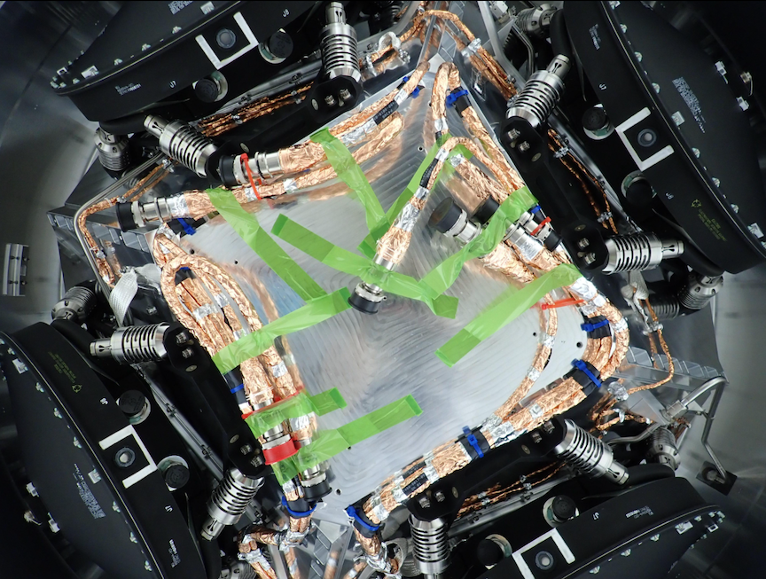
Astrobiology news this week…
All 4 reaction wheels installed on NASA’s Europa Clipper Jupiter orbiter, on schedule to launch in 2024 for a 2030 insertion at the Jupiter system.
Perseverance finds evidence of organic carbon (PAHs) in aqueously formed minerals at Jezero crater (sample target areas shown) (Scheller et al., 2022 - Science)

Slide 2
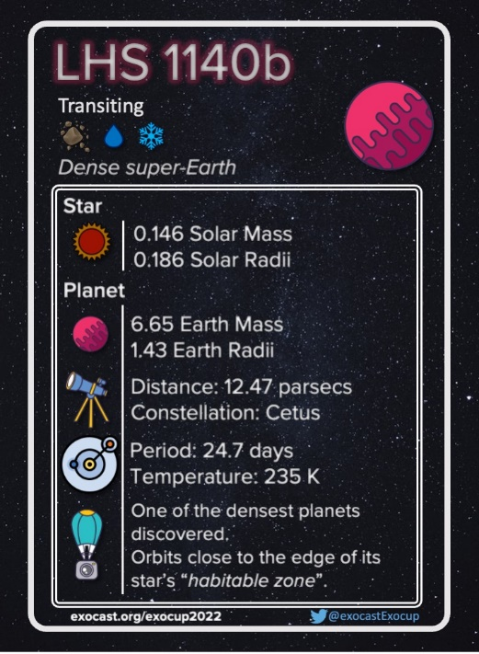
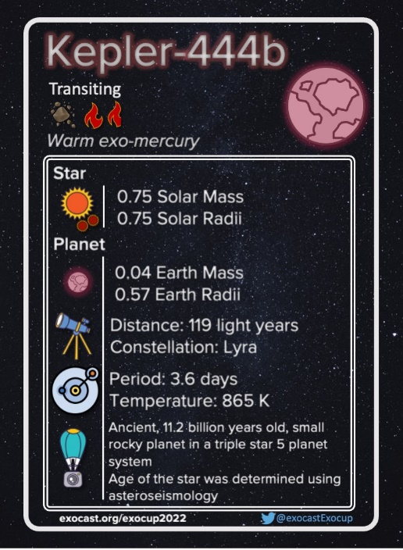
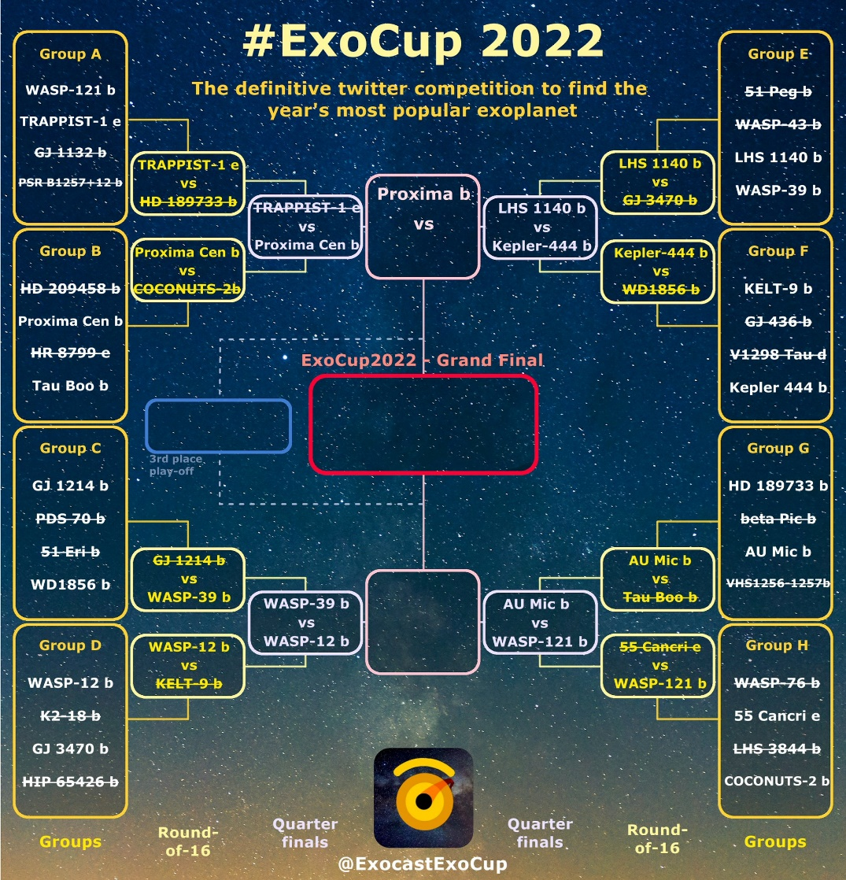
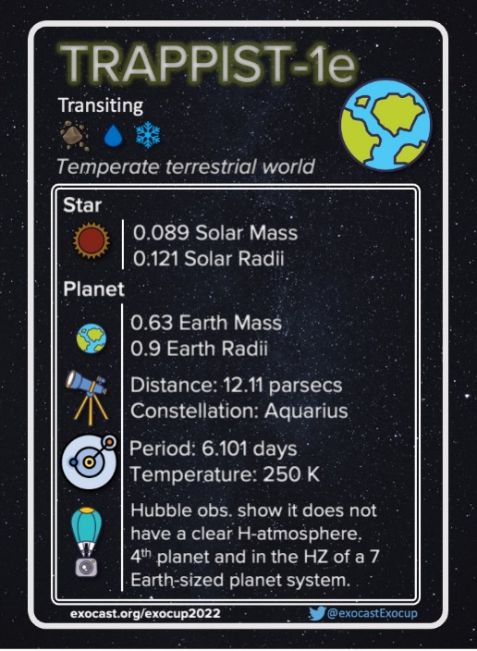
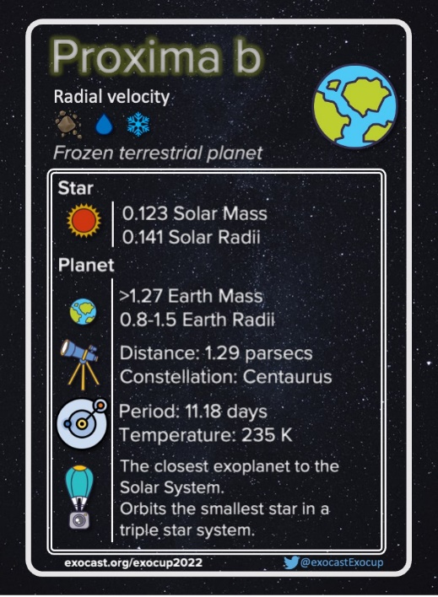
#ExoCup2022 – Quarter finals underway!

Slide 3
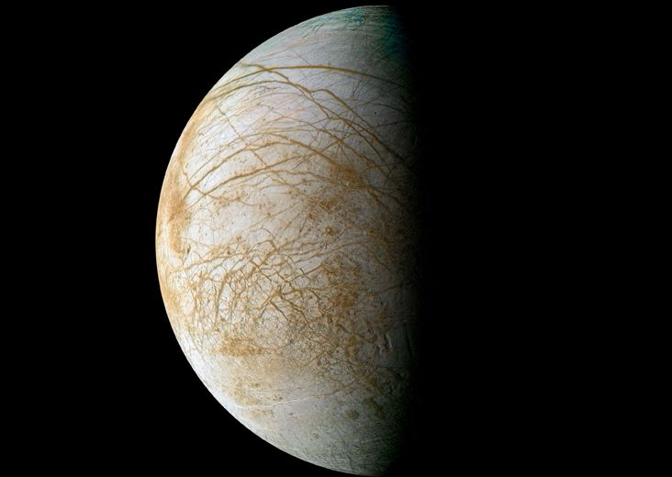
Life Elsewhere in the Solar System

Slide 4
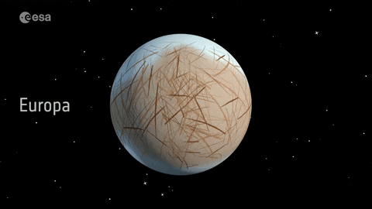
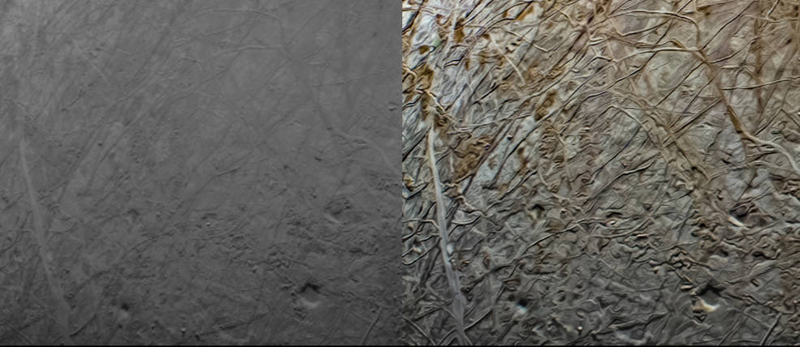
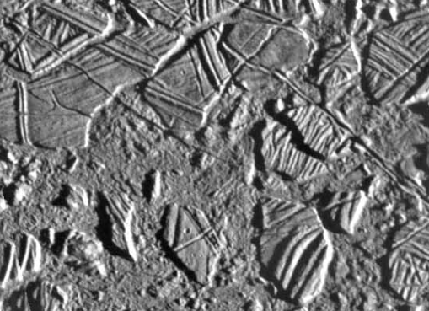
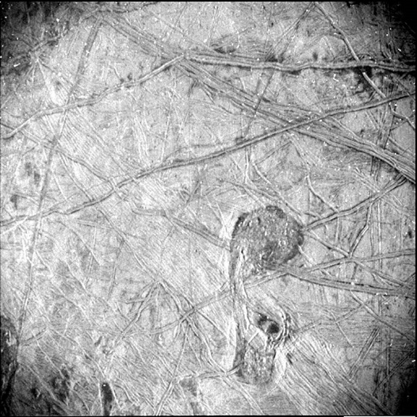
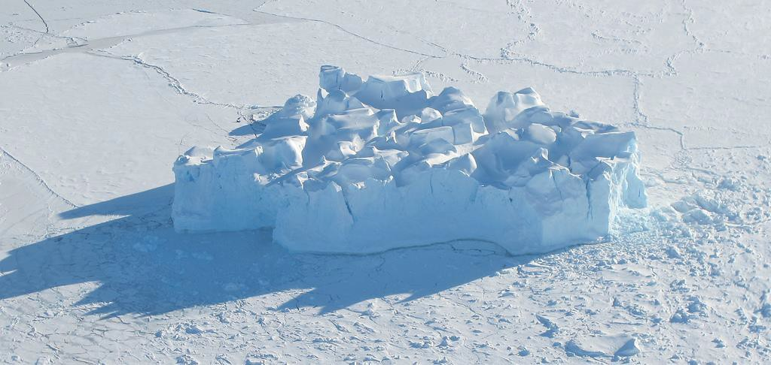
Europa
This pair of images shows the same portion of Europa as captured by the Juno spacecraft. The image (right) has been processed to enhance color contrast to allow larger surface features to stand out. Credits: Image data: NASA/JPL-Caltech/SwRI/MSSS Image processing: Navaneeth Krishnan S © CC BY
‘Chaotic Terrain’
Iceberg trapped in sea ice on Earth for comparison

Slide 5
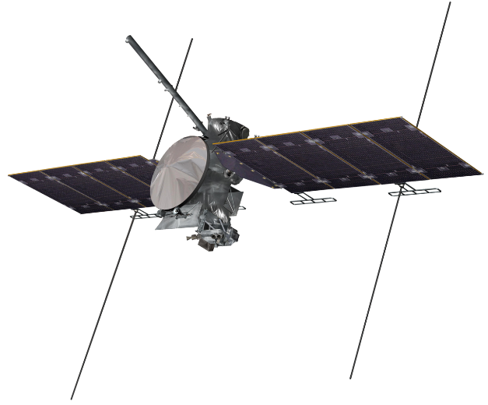
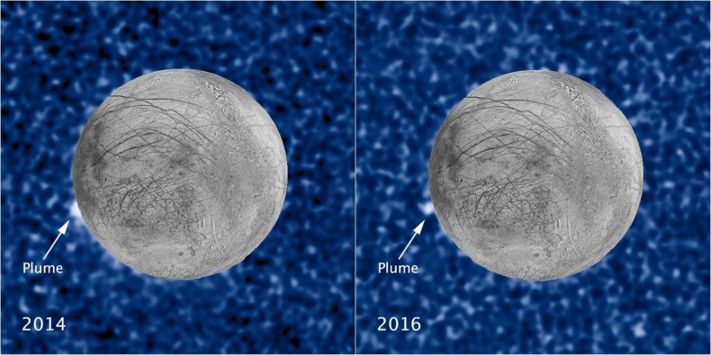
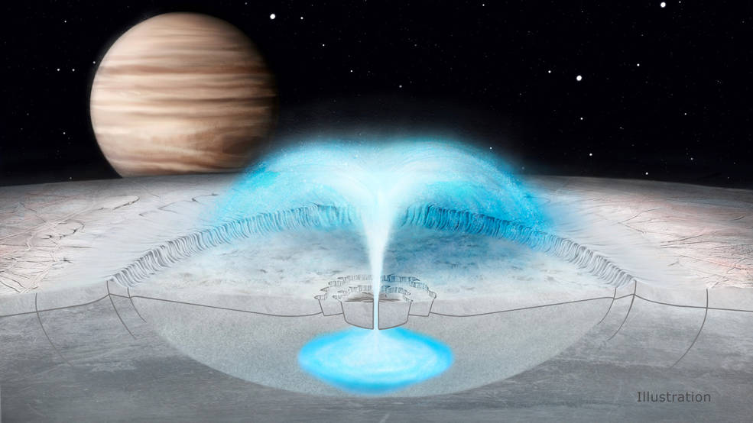
Lakes & Plumes
NASA’s Europa Clipper
Composite HST/Galileo images, show a suspected plume of material erupting from the same location on Europa (NASA).
Mariner 4 image , 1965 (NASA)

Slide 6
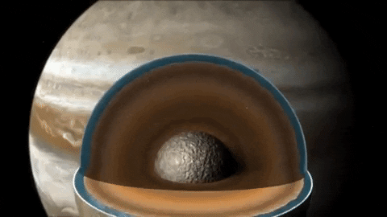
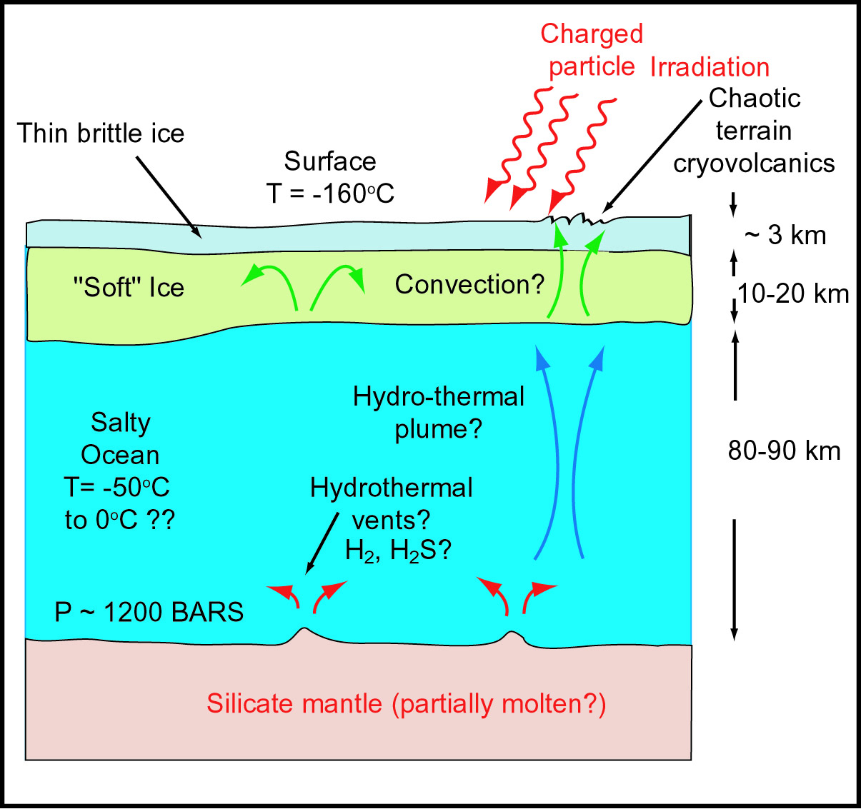
Europan Ocean Habitability
Average density: 3g cm⁻³
(similar to Earth’s moon)
Plausible metabolisms:
4H₂ + CO₂ → CH₄ + 2H₂O
(methanogenesis)
4H₂ + 2CO₂ → CH₃COOH + 2H₂O
(acetogenesis)

Slide 7
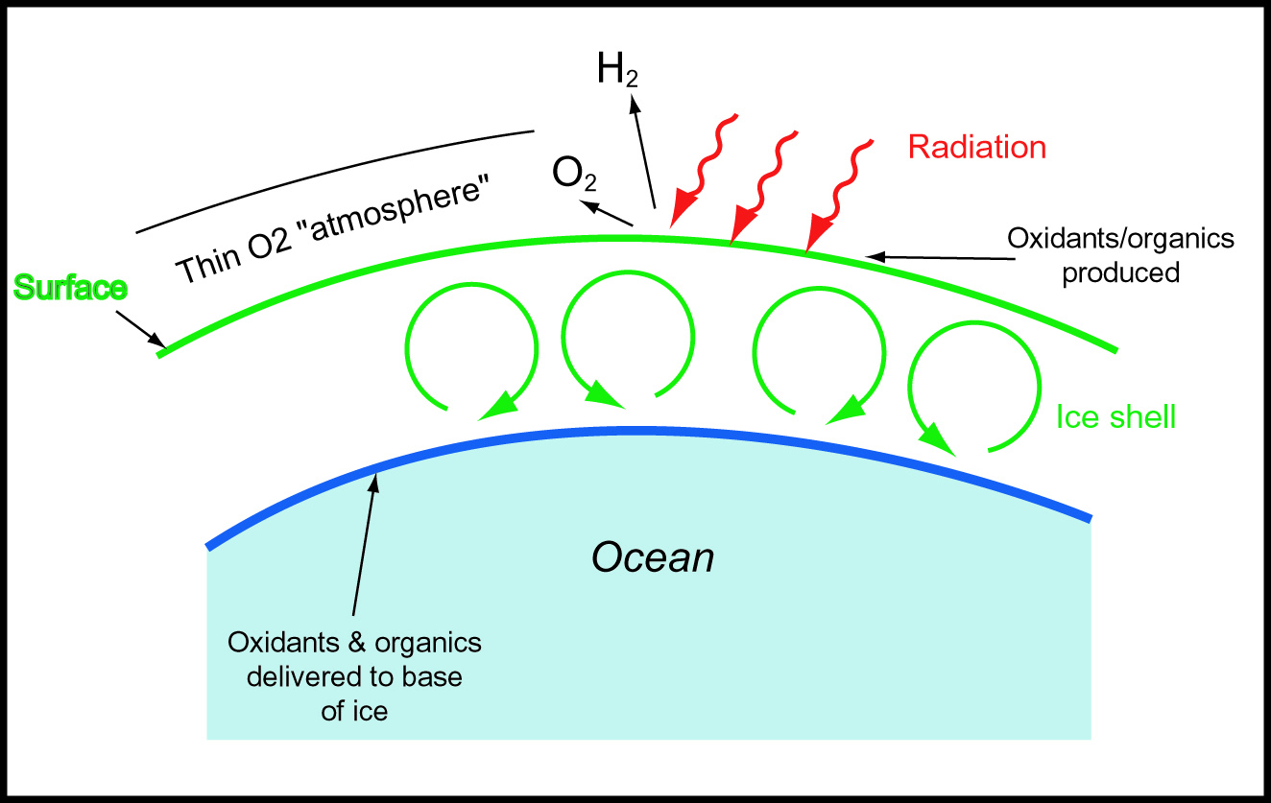
Europan Surface/ Atmosphere
-4 0 +4 km
Plausible metabolisms:
H₂S + CO₂ + O₂ + H₂O → “CH₂O” + H₂SO₄
_{(Sulphur oxidation)}

Slide 8
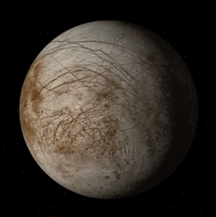
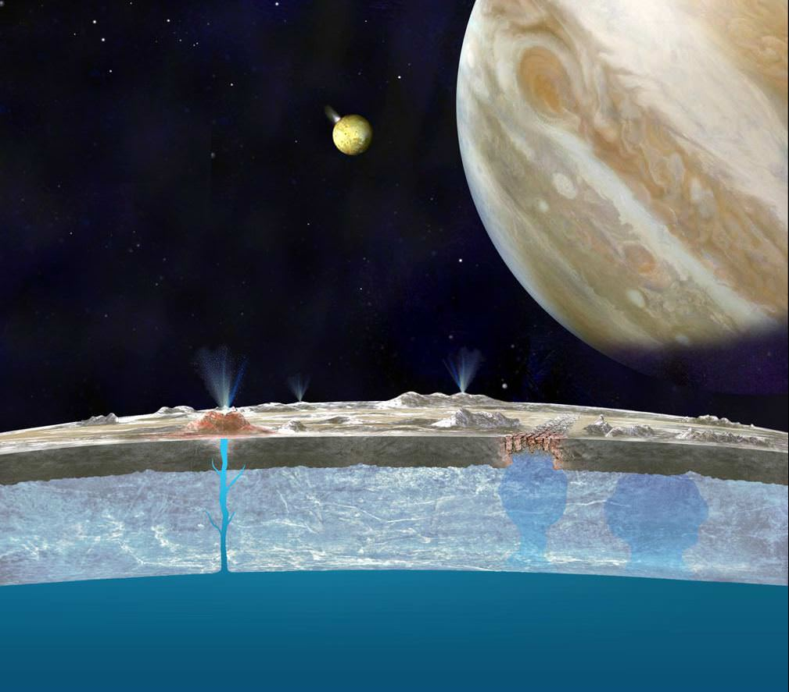
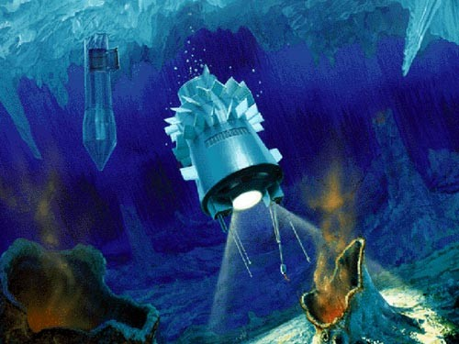
Searching for life on Europa

Slide 9
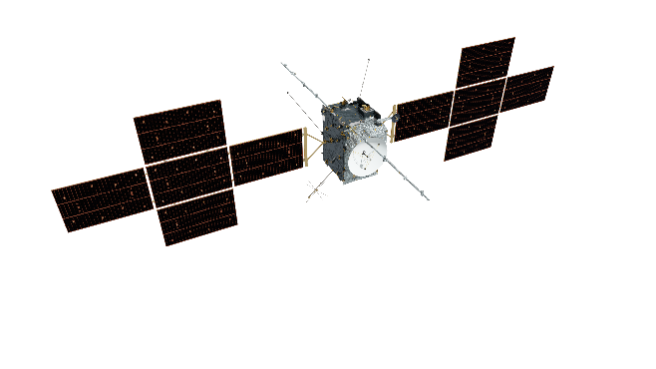
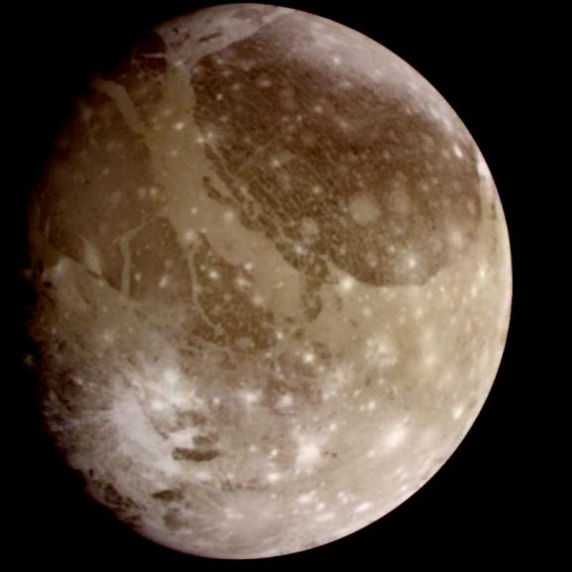
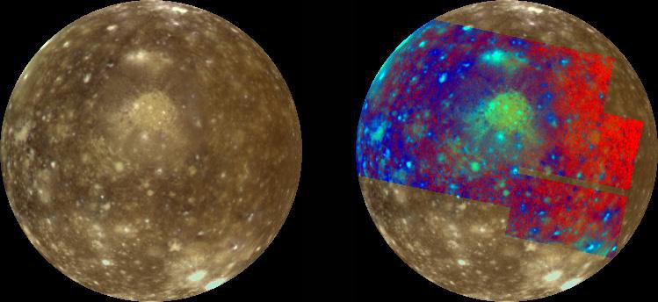
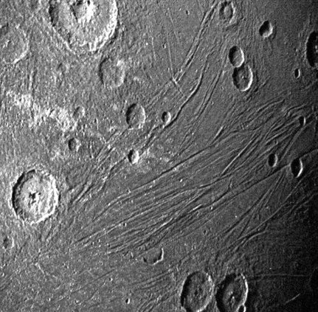
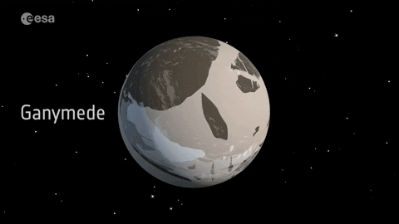
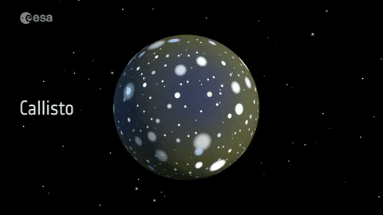
Ganymede & Callisto
ESA’s JUICE orbiter (2023)
Salt hydrates?
Galileo image of Ganymede (1998) (NASA)
Juno SRU image (2021) of Ganymede surface (NASA)
Galileo image of Callisto in natural colour (L) and false colour (R) (1997) (NASA)

Slide 10
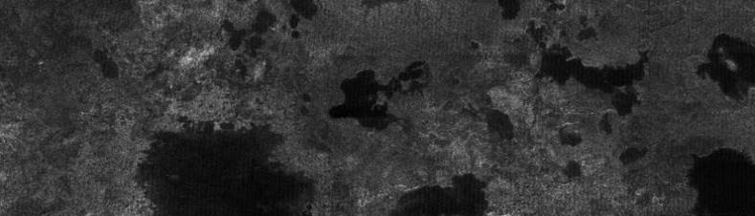
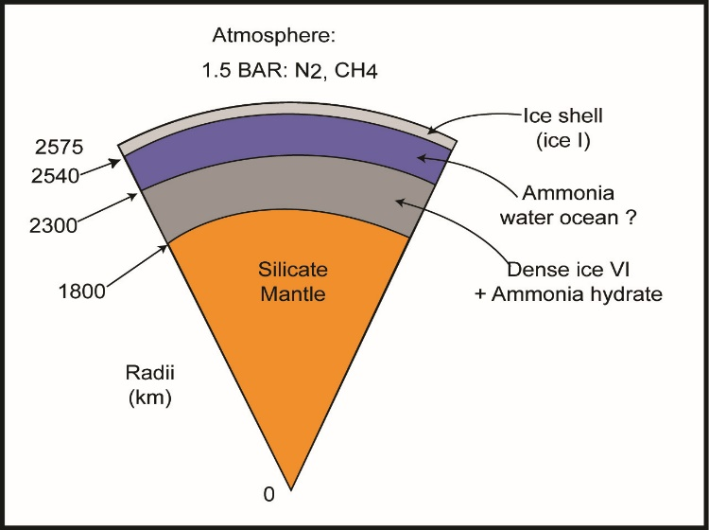
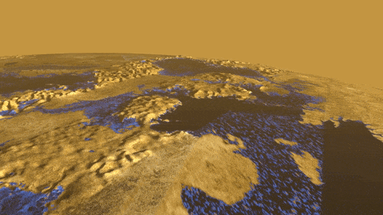
Titan
Cassini radar strips of the surface of Titan at a latitude of about 80◦ N. Dark irregular areas of low radar reflectivity are interpreted to by hydrocarbon lakes. Image size is 150×420 km (NASA).
Possible internal structure of Titan (Fortes, 2006)
False-color image of the surface of Titan from Cassini (2013). Titan’s second largest lake, Ligeia Mare, is clearly visible.

Slide 11
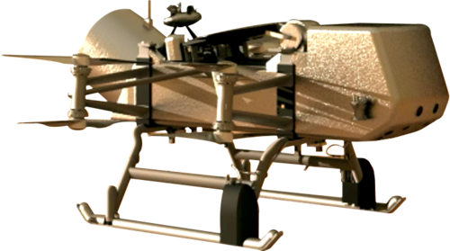
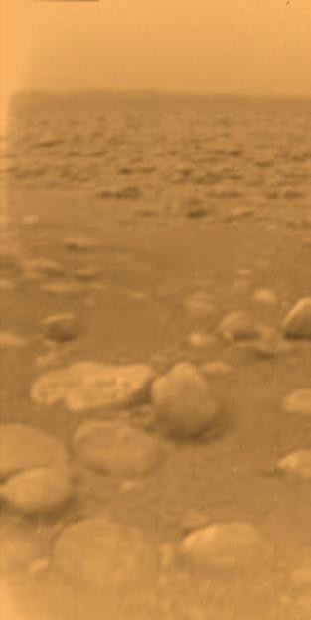
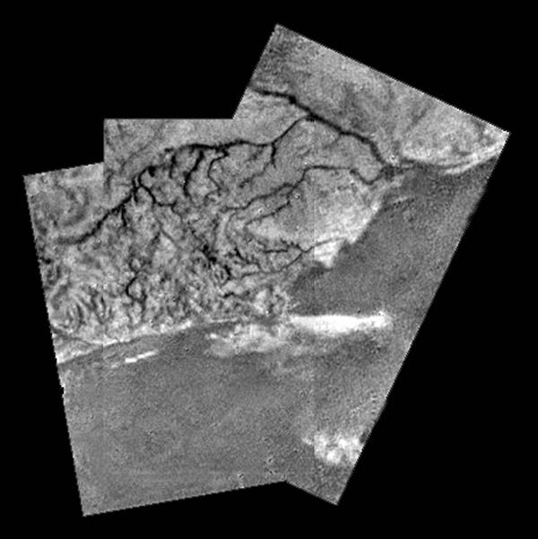
Titan’s surface
NASA’s Dragonfly (2027)
5 km
Rivers on Titan (Huygens lander, ESA)
Visible light image of the surface of Titan, last image taken by Huygens (ESA)

Slide 12
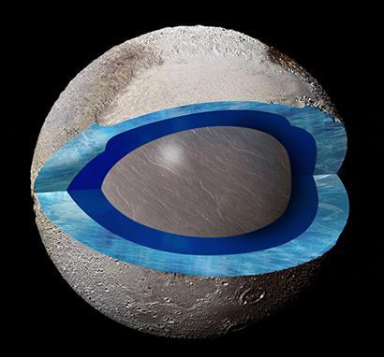
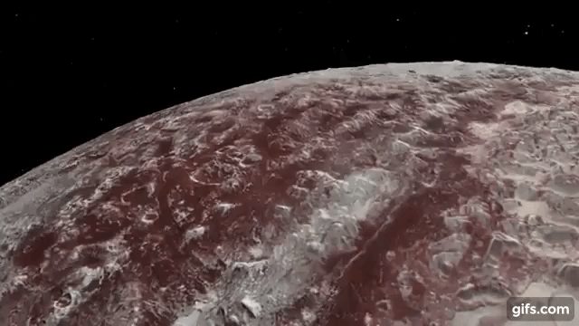
Pluto
New Horizons flyby of Pluto’s icy surface. (NASA, 2015)
Possible interior structure of Pluto mirrors that of other icy moons in the outer Solar System.

Slide 13
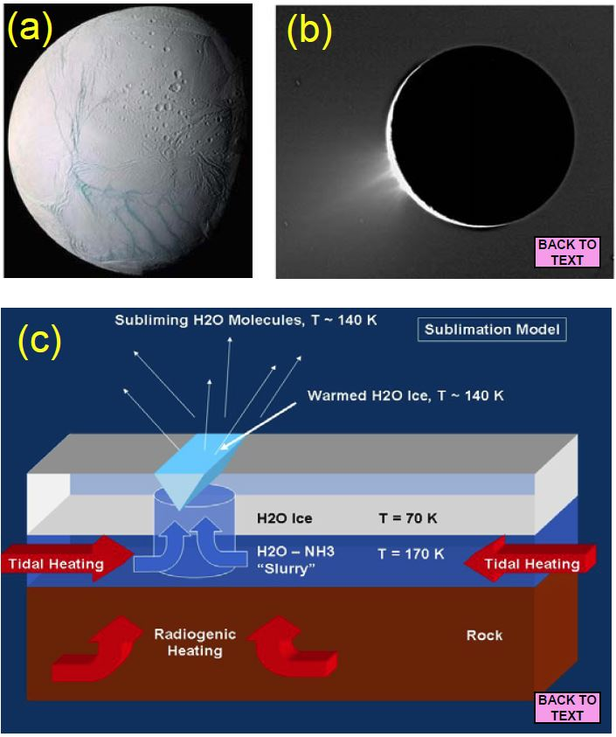
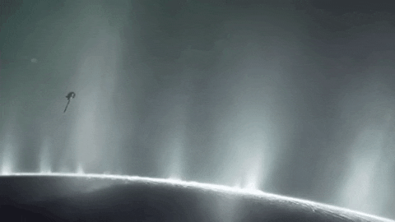
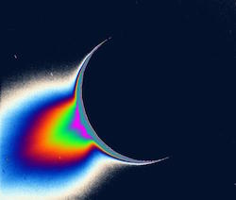
Enceladus
Cassini passes the plumes of Enceladus in 2008 (artists visualisation)
Cassini images of Saturn's moon Enceladus backlit by the sun show the fountain-like sources of the fine spray of material that towers over the south polar region.

Slide 14
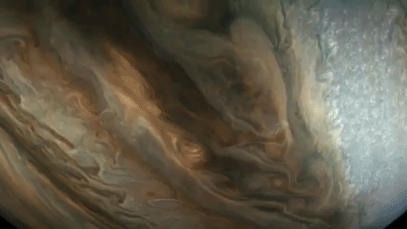
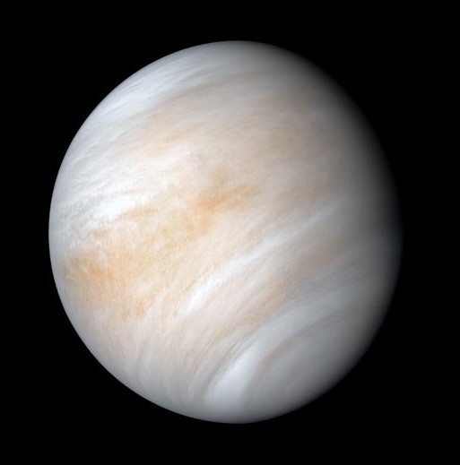
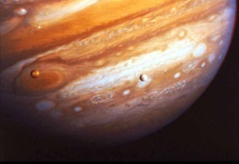
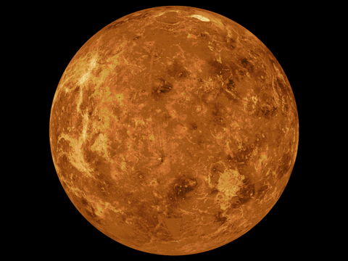
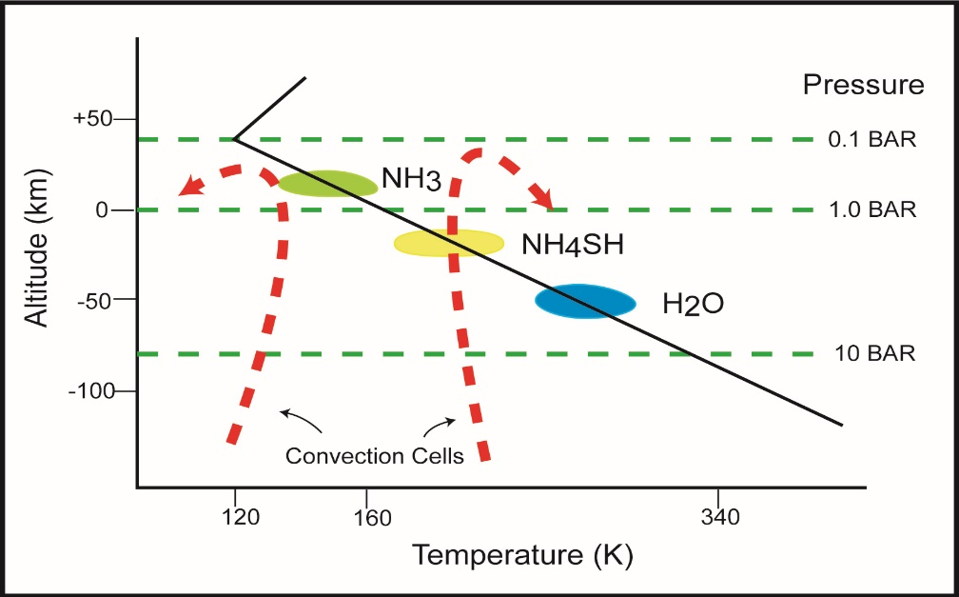
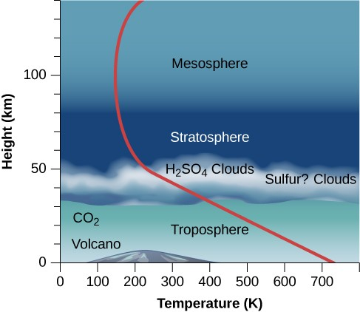
Planetary Atmospheres
Jupiter
Venus

Slide 15
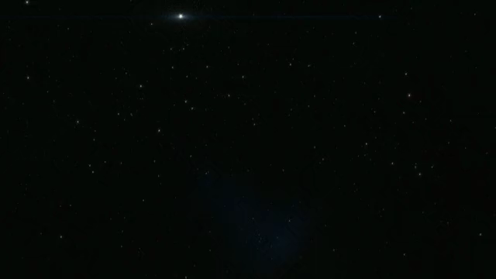
Panspermia

Slide 16
Panspermia
$$P_{AB}= P_{biz}×P_{ee}×P_{sl}×P_{ss}×P_{se}×P_{si}×P_{rel}×P_{st}×P_{sp}×P_{efg}×P_{sc}$$
P_{AB} |  | Probability of successful transplant to planet B of viable organisms due to any given hypervelocity impact onto planet A
Ejection | P_{biz} | Probability that the impactor is into a biologically inhabited zone
 | P_{ee} | Probability of ejection onto an escape trajectory
 | P_{sl} | Probability that an organism survives the launch (impact temperature, pressure, ejection erosion)
Transit | P_{ss} | Probability of survival in space (radiation, desiccation, thermal inactivation)
Re-entry and impact | P_{se} | Probability of surviving entry through the target atmosphere.
 | P_{si} | Probability of surviving impact onto the target surface.
 | P_{rel} | Probability of release (for entombed organisms)
 | P_{st} | Probability that the environment is non-toxic (appropriate pH, Eh, osmolarity)
 | P_{sp} | Probability of surviving predators in the target biosphere.
 | P_{efg} | Probability of reaching an environment favourable for growth.
 | P_{sc} | Probability of successfully competing with indigenous organisms in the environment.
(Clark, 2001)

Slide 17
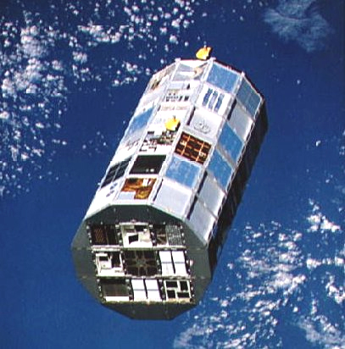
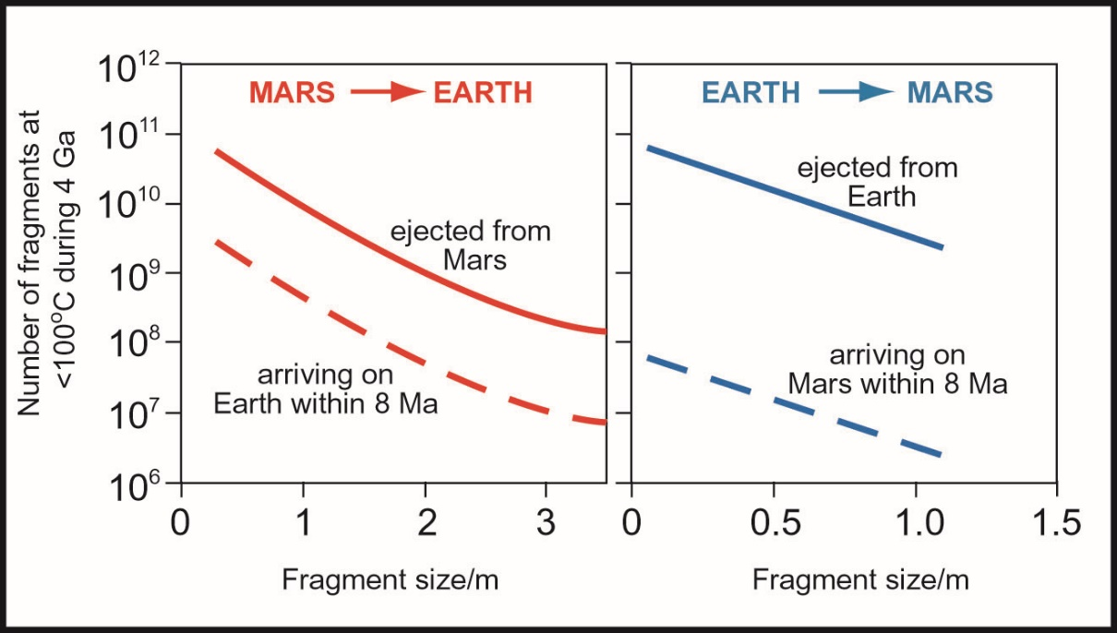
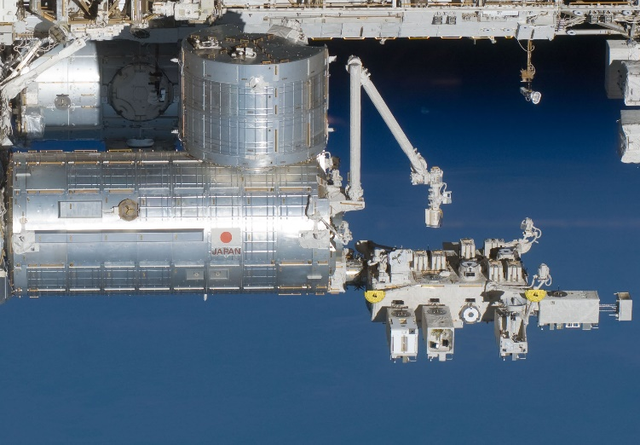
Panspermia
NASA’s Long Duration Exposure Facility (LDEF), on which a range of bacterial spores were exposed to the space environment for six years before being retrieved by the Space Shuttle (NASA).
Theoretical calculations showing the number of meteorites exchanged between Mars and Earth, and Earth and Mars, over the last 4 billion years.
The Japanese Kibo module attached to the ISS (left) and the ‘Exposed Facility’ (right) where the panspermia experiments reported by Kawaguchi et al. (2020) were performed (NASA).

